Slide 1

Lecture 2
-NLP is all about words, their arrangement and their meaning
-NLP is a branch of AI that tries to emulate/understand the way a human speaks to another human
-Lecture 2 is about stemming (Porter’s stemmer, 1980)

Slide 2
Porter’s stemmer…………
Word→Stem (+Suffix)
Porter wrote an algorithm for stripping off the suffix
Set of rules→To be followed in steps from top to bottom
Maybe more than one of these rules will work out as you go from top to bottom (once).

Slide 3
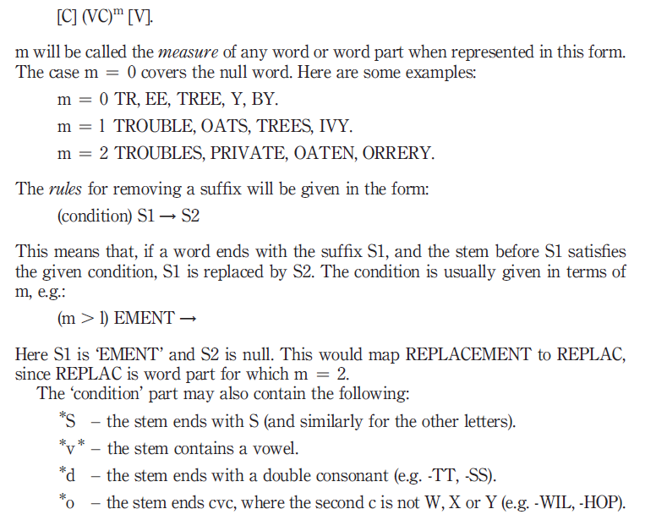
Notations

Slide 4
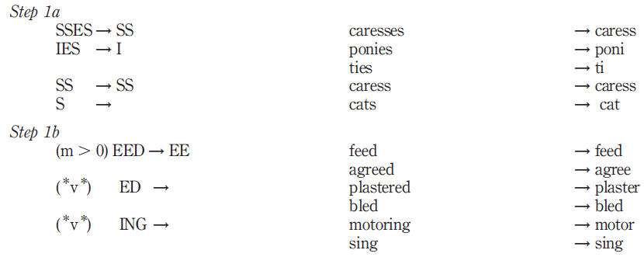
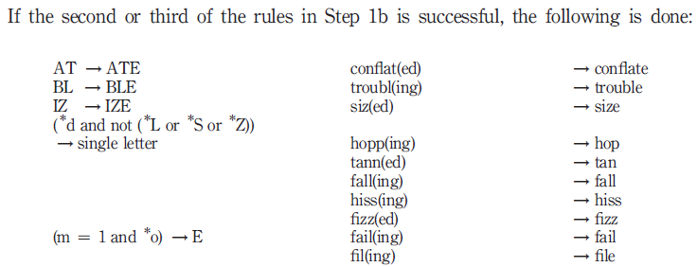
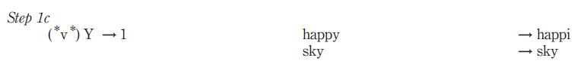
Porter’s stemmer…………Step 1

Slide 5
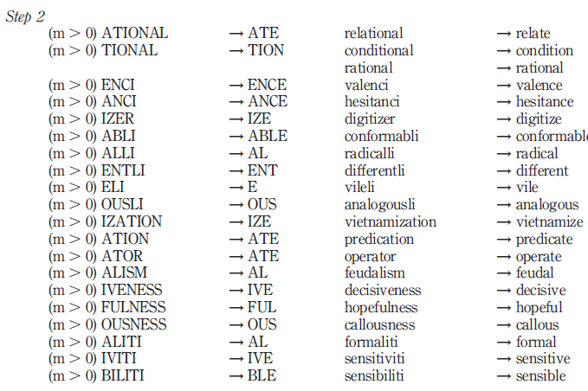
Porter’s stemmer…………Step 2

Slide 6
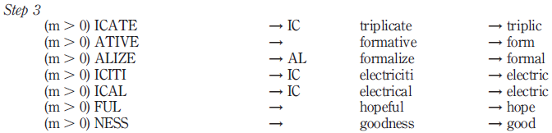
Porter’s stemmer…………Step 3

Slide 7
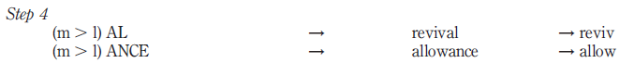
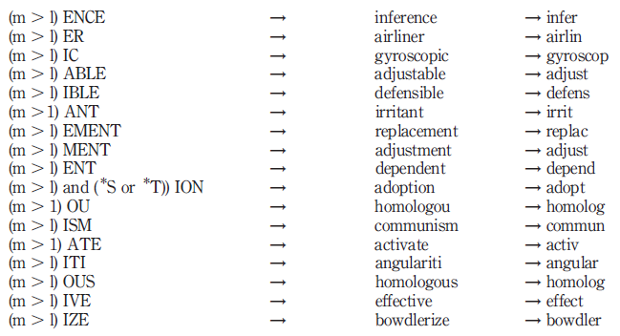
Porter’s stemmer…………Step 4

Slide 8
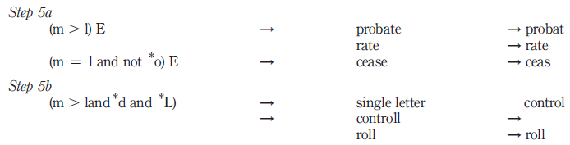
Porter’s stemmer…………Step 5

Slide 9
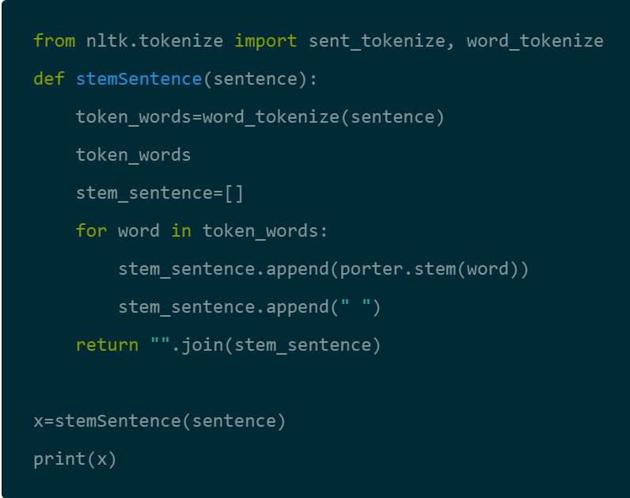
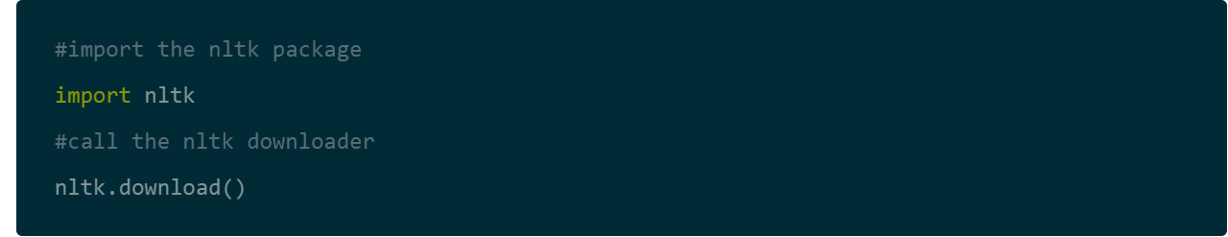
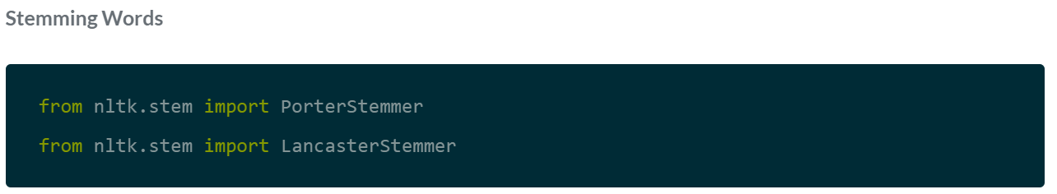
Practical demo……….
https://www.datacamp.com/community/tutorials/stemming-lemmatization-python

Slide 10
Now for Assignment 2 (Sunday 16th Aug 2020, 11 pm) -Implement porter’s stemmer for your resume/CV. -Show the program, your input text and stemmed output -Discuss the output you have obtained on whether stemming was advisable for your project or not

